Slide 1
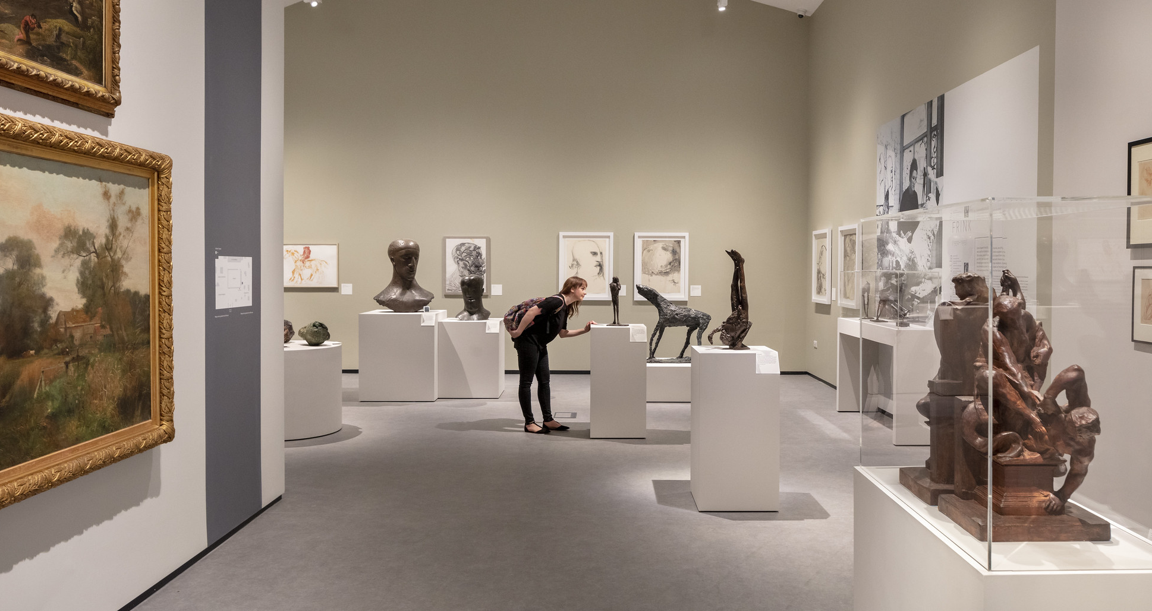
Museum Estate and
Development Fund
Round 4
#LetsCreate
Notes:
Thank you for joining us today for this webinar for the third round of the Museum Estate and Development Fund.
We'll start soon but before we do, a little bit of housekeeping:
We are joined today by two BSL interpreters, Clare Cryer and Jo Ross, who have "BSL interpreter” in their screen name. You can use the three dots over their picture to pin them to your screen if you want to see them throughout the session
We also have live captions available, to switch those on click the ‘Closed Captions’ button at the top or bottom of your screen
The webinar will take the form of a presentation followed by a Q&A session
Please post questions in the Q&A box and we’ll either provide a written answer or we’ll answer them live in the webinar
We are recording this session so if you wish to remain anonymous you can check the "send anonymously" box when posting a question.
Now that we've done some housekeeping, I'll get started!
Welcome to Arts Council England's applicant webinar for the Museum Estate and Development Fund (or MEND).
We are very pleased to announce the fourth round of this capital fund for 2024-25, and we'll be sharing more information on this in today's presentation. Before we begin, I'd like to introduce our panellists today...

Slide 2
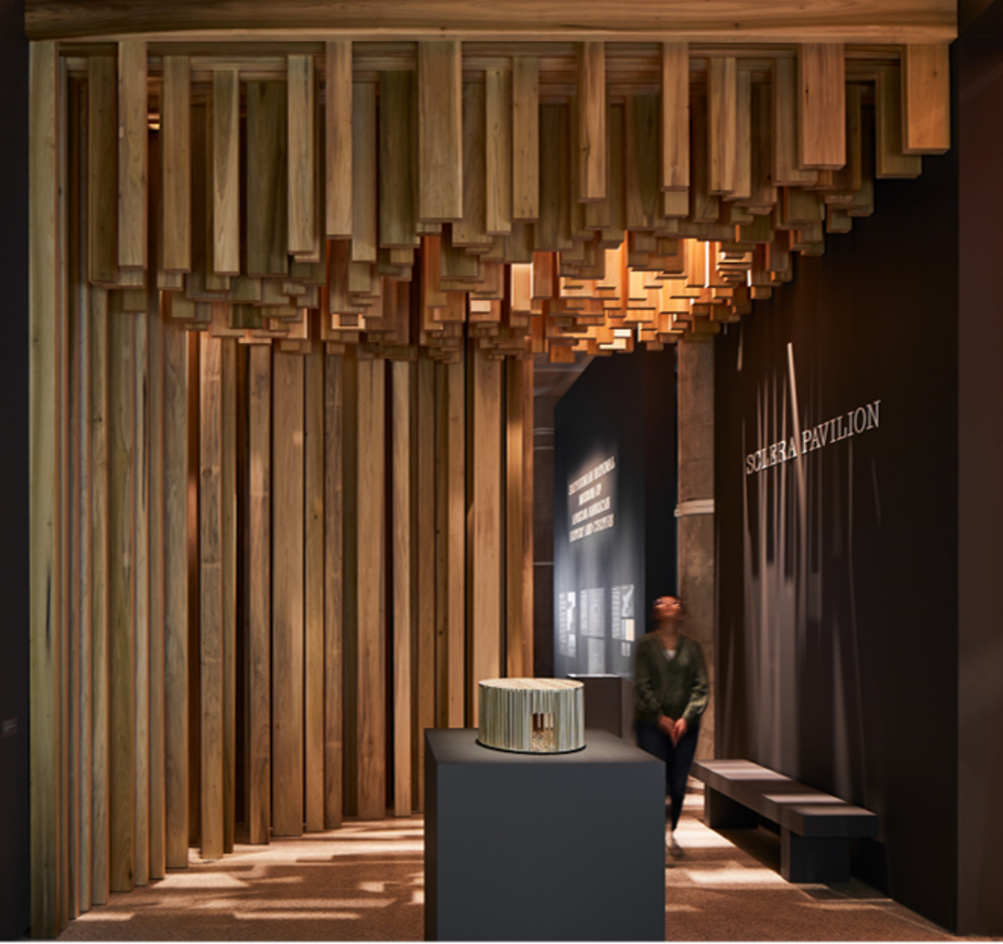
Liz Johnson - Director, Museums and Collections,
Arts Council England
Georgina Parker - Senior Officer, Collaborative Funding (Capital),
Arts Council England
Clare Charlesworth - Head of Region, Historic England
Eleanor Skidmore – Senior Officer, Training & Advice,
Arts Council England
© Yorkshire Festival
© Yorkshire Festival
Almeida – This Isn’t (A True Story) © Ali Wright
#LetsCreate
Notes:
I'm Liz Johnson, and I am the Director, Museums and Collections at Arts Council England. I am the lead for the MEND programme.
I am joined by Georgina Parker, who looks after the grant-making process for MEND.
We are also joined by Clare Charlesworth from Historic England, who will talk about their role in the application and decision-making process.
Eleanor Skidmore, Senior Officer for Training and Advice will be joining to chair the Q&A, at the end of the session.

Slide 3
Cultural Investment Fund
Museum Estate and Development Fund (MEND): Round Four
Targeted at non-national Accredited museums to undertake vital infrastructure and urgent maintenance backlogs.
Libraries Improvement Fund (LIF): Round Three
To enable library services across England to invest in a range of projects to upgrade buildings and technology.
Cultural Development Fund (CDF): Round Four
The fund will unlock local growth, productivity and regenerate communities through capital investment in culture.
© Yorkshire Festival
Almeida – This Isn’t (A True Story) © Ali Wright
#LetsCreate
Notes:
MEND is part of a package of three funds that make the Cultural Investment Fund. Arts Council England is working with the Department for Culture, Media and Sport (DCMS), Historic England and the National Lottery Heritage Fund to deliver them. We'd like to begin with a brief overview of these three funds:
Museum Estate and Development Fund (MEND)
Targeted at non-national Accredited museums to undertake vital infrastructure and urgent maintenance backlogs which are beyond the scope of day-to-day maintenance budgets.
Budget: £23.8 million in 2024/25.
Libraries Improvement Fund (LIF)
To enable library services across England to invest in a range of projects to upgrade buildings and technology so they are better placed to respond to the changing ways people are using them.
Budget: the final round of LIF was launched in 2023/24 and had a budget of £10.5 million in 2023/24.
Cultural Development Fund:
The fund will unlock local growth, productivity and regenerate communities through capital investment in culture. This programme is following a different timetable to MEND and LIF, and the next round will be launched in 2024.
You can find out more about these funds on the Arts Council website.

Slide 4
Overview
Urgent repair and maintenance work
Identified need in the next 1 to 2 years
Funding from 17 April 2025 to 31 March 2028
£50,000 to £5 million applications
MEND has a budget of £23.8 million for this round
Competitive fund, we anticipate high demand
© Yorkshire Festival
Almeida – This Isn’t (A True Story) © Ali Wright
#LetsCreate
Notes:
As an overview, MEND is designed to fund urgent repair and maintenance work with identified need within the next 1 to 2 years. This programme can fund capital expenditure only.
The funding will be awarded for projects running from April 2025 to March 2028. Projects must begin by mid-May 2025.
Applications can range from £50,000 to £5 million, with an overall budget of £23.8 million for this round.

Slide 5
Aims of the fund
Improved core infrastructure by tackling maintenance backlogs
Reduce the immediate risks to buildings, visitors, staff and collections
More financially resilient and environmentally responsible
Environmental performance of buildings and equipment is improved
Independent access for disabled people and accommodation of diverse user needs
Strengthened contribution to local community and regeneration
© Yorkshire Festival
Almeida – This Isn’t (A True Story) © Ali Wright
#LetsCreate
Notes:
There are 2 main impacts we expect to see from this investment:
Firstly, Museums across England who are awarded a MEND grant will improve their core infrastructure by tackling their maintenance backlogs.
Secondly, Museums across England who are awarded a MEND grant will reduce the immediate risks to buildings, visitors, staff and collections due to improved core infrastructure.
In terms of outcomes, there are a few things we expect to see from recipients of this investment:
Museums will become more financially resilient and environmentally responsible by developing and implementing maintenance plans.
The environmental performance of buildings and equipment will be increased, supporting the reduction in carbon emissions in the museum sector.
Museums’ ability to offer independent access for disabled people and accommodation of diverse user needs will be improved.
Museums will have strengthened their contribution to the local communities and regeneration by preserving landmark buildings and ensuring locally treasured collections are accessible to the public.

Slide 6
Timeline
Expression of Interest (EOI)
EOIs Considered
Application
Application Assessed
Balancing Panel
Decisions
4 March –
18 April
2024
28 May –
15 August
2024
March 2025
© Yorkshire Festival
Almeida – This Isn’t (A True Story) © Ali Wright
#LetsCreate
Notes:
The portal for Expressions of Interests opens on Grantium at 9am on Monday 4 March 2024
Deadline is 12pm (midday) on Thursday 18 April 2024
Reviews will take place over the following two weeks & projects with strong potential will be invited to submit full application
Full applications open on Grantium at 9am on 28 May 2024
Deadline is 12pm (midday) on 15 August 2024
Final decisions will be made by our Executive Board in March 2025

Slide 7
Who can apply?
Non-national Accredited museums based in England
Local authorities based in England who are responsible for maintenance of non-national Accredited museum buildings
Partnership applications between a local authority and Accredited museum(s)
© Yorkshire Festival
Almeida – This Isn’t (A True Story) © Ali Wright
Children from Ingleton School working on arts projects, The Bowes Museum. Photo: Jason Hynes // The Bowes Museum
#LetsCreate
Notes:
MEND is an open-access capital fund, which invites non-national Accredited museums and local authorities based in England to bid for funding to make long-term strategic investments in museums’ core infrastructure.
Applicants must be:
● non-national Accredited museums based in England
● local authorities based in England who are responsible for the maintenance of non-national Accredited museum buildings
● partnerships between a local authority and a non-national Accredited museum based in England
Organisations who applied in rounds one, two and three can also apply in round four, including those who were funded. If they have started their MEND funded activity and found that it will be more expensive than anticipated, then they can't apply to round four to top up their original grant. If, however, there is a second phase to the works we are funding which is distinct and which was not included in their funded application then they can apply for that. Unsuccessful and ineligible applicants from rounds one, two and three can reapply for the same activity.

Slide 8
What activity can be supported?
Protecting fabric/longevity of the structure
Protecting the exhibits and collections
Upgrading building services
Improving environmental performance of museum infrastructure
Addressing equality and accessibility through your project
© Yorkshire Festival
Almeida – This Isn’t (A True Story) © Ali Wright
#LetsCreate
Notes:
It is anticipated that the fund will be investing in the following broad categories:
• protecting fabric/longevity of the structure
• repairs to the fabric of the building so that exhibits and collections are protected
• upgrading building services (direct questions to HE colleagues in Webinar)
• improving environmental performance of museum infrastructure through repairs
• addressing equality and accessibility through your project
These must all be costs that can be capitalised on your organisation’s balance sheet.
We expect all the capital requirements you wish to apply for on one museum site to be included within one application. Multiple museum buildings can be included in one application, as long as they are on the same museum site and are accredited.

Slide 9
Before you apply
Detailed plans and costs
Costed condition survey required
Developed to at least RIBA Work Stage 3 where relevant
Access audit required, if including access works
Ensure that you have a validated profile on Grantium, with up-to-date contact details
© Yorkshire Festival
Almeida – This Isn’t (A True Story) © Ali Wright
#LetsCreate
Notes:
Prior to submitting an application:
applicants will need to have detailed plans and proposals for the capital work, including a recent costed condition survey (within the last five years, with costs updated within the last twelve months) undertaken by an appropriately qualified professional. This will be a mandatory attachment on your Expression of Interest and application
if your project includes works to building services then your costed condition survey should include building services
plans for architectural and engineering elements must have completed at least RIBA Work Stage 3 at the point of submitting your full application, if you are following RIBA Work Stages. If you are not following RIBA Work Stages, plans should be developed to the equivalent of RIBA Work Stage 3
freehold or leasehold ownership of the land and buildings
an access audit will also be required if your proposal includes access works

Slide 10
RIBA Plan of Work
Stage 0 – Strategic Definition
Stage 1 – Planning and Preparation
Stage 2 – Concept Design
Stage 3 – Spatial Coordination – by 15 August 2024
Stage 4 – Technical Design
Stage 5 – Manufacturing & Construction
Stage 6 – Handover
Stage 7 – Use
© Yorkshire Festival
Almeida – This Isn’t (A True Story) © Ali Wright
#LetsCreate
Notes:
It is an eligibility requirement that projects complete RIBA work stage 3 (if following RIBA work stages) before applying. If you are not following RIBA work stages (for example, a like-for-like boiler replacement), then your plans should be at an equivalent level of development.
The RIBA Plan of Work 2020 is a procedural guide for architects and construction working on building projects. There are 8 stages in this plan.
What is Workstage 3 and why do we require it? Stage three is titled ‘Spatial Coordination’ and, as the name suggests it’s where the idea, or the initial concepts and sketches, are applied to the space in which the work is to be done. In technical terms, the architectural concept is validated through design studies and engineering analysis. What that means in layman’s terms is that qualified people will look at the work to date, measure up the existing space, measure up the work to take place, test it out, plan it and draw it in on a computer. It will be drawn to scale so we’ll usually see measurements or scales in there, there might be design notes, they might be floor plans and/or cross sections. These drawings allow us to not only visualise the work to be carried out, but it shows us that it is viable and gives the cost consultant (such as a QS) a level of detail that allows them to more accurately estimate the cost of the project.
A cost plan is a document that outlines how much everything will cost, covering things like materials costs, site management and labourer’s fees, preliminaries (on-site overheads for construction). They’ll also include assumptions, exclusions, potential risks and their costs and information on who prepared it. They won’t cover income or non-construction costs.
It’s imperative the Cost Plan is based on the stage 3 drawing as this will provide the most up to date and accurate reflection of the expected costs. If you’re working with an architect or cost consultant (such as a quantity surveyor) they will prepare these documents.

Slide 11
Partnership funding
£50,000 - £499,999 – 5 per cent
£500,000 - £5 million – 10 per cent
© Yorkshire Festival
Almeida – This Isn’t (A True Story) © Ali Wright
Football Creates - National Football Museum. Photo © David Mansell
#LetsCreate
Notes:
You will also need to tell us about your expected or confirmed partnership funding. The minimum requirements are:
- For grants between £50,000 to £499,999 – 5 per cent of the total project costs must come from other sources.
- For grants from £500,000 to £5 million – 10 per cent of the total project costs must come from other sources

Slide 12
Leases
Lease length requirements (without break clause):
£50,000 up to £499,999 = 10 years
£500,000 to £999,999 = 15 years
£1,000,000 to under £5 million = 20 years
£5 million = 30 years
There is an option to negotiate a Deed of Variation – you may wish to think about this now
© Yorkshire Festival
Almeida – This Isn’t (A True Story) © Ali Wright
#LetsCreate
Notes:
You will need to demonstrate that you own the land and/or buildings (either as a freehold or leasehold) on which you spend the grant, and that the land and/or buildings can be used for the project purposes. Please note our requirements on leasehold interests:
• for grants from £50,000 up to £499,999: a registered lease of at least 10 years
• for grants of £500,000 and above but less than £1,000,000: a lease of at least 15 years
• for grants of £1,000,000 and above but less than £5 million: a lease of at least 20 years
• for grants of £5 million: a lease of at least 30 years
If your lease does not meet our leasehold requirements, you will need to arrange with the freeholder for a Deed of Variation of the lease to be completed in order that it complies. We would require this to be in place prior to any grant payments being released. We would recommend that leaseholders who would need a Deed of Variation begin the conversation with their freeholder as soon as possible, even before the application is submitted, to ensure agreement on both sides.
You need to tell us about your lease and freehold status at the point of application, not your expected or planned status at the point of potential award. Further details are set out in Section four – capital requirements in the applicant guidance.

Slide 13
Expression of Interest
Do proposals meet all eligibility criteria and aims and outcomes of this fund
Describe your outline proposal in no more than 2,500 characters (around 400 words)
Projects with strong potential will be invited to submit full applications
Opens on Grantium at 9am on Monday 4th March 2024
Deadline is 12pm (midday) on Thursday 18th April 2024
© Yorkshire Festival
Almeida – This Isn’t (A True Story) © Ali Wright
#LetsCreate
Notes:
The application process will begin with an Expression of Interest stage, which all applicants must complete before being able to submit a full application.
Your Expression of Interest will need to meet all of the eligibility criteria and the aims and outcomes of the fund, as outlined in the applicant guidance. You will need to describe your outline proposal in no more than 2,500 characters, which is around 400 words.
A costed condition survey is a mandatory attachment on your expression of interest, as well as your application. This is one document. If your project includes works to building services then building services should be included in your costed condition survey, this should cover the entirety of your building services, and not only those included in the application. This is because the detail in your costed condition survey should inform both which works are included in your project, based on identified levels of urgency, and your cost plan.
Costed condition surveys should have been completed within the last 5 years, with costs updated within the last 12 months. This is because costs across the building sector have increased drastically in the last year, so for your budget to be realistic it needs to be based on recent costs.
Projects that are considered to have a strong potential to deliver against the aims and outcomes of the fund will be invited to submit a full application. Notifications will be sent to applicants by the [25th May] informing them of whether or not they have been invited to apply.

Slide 14
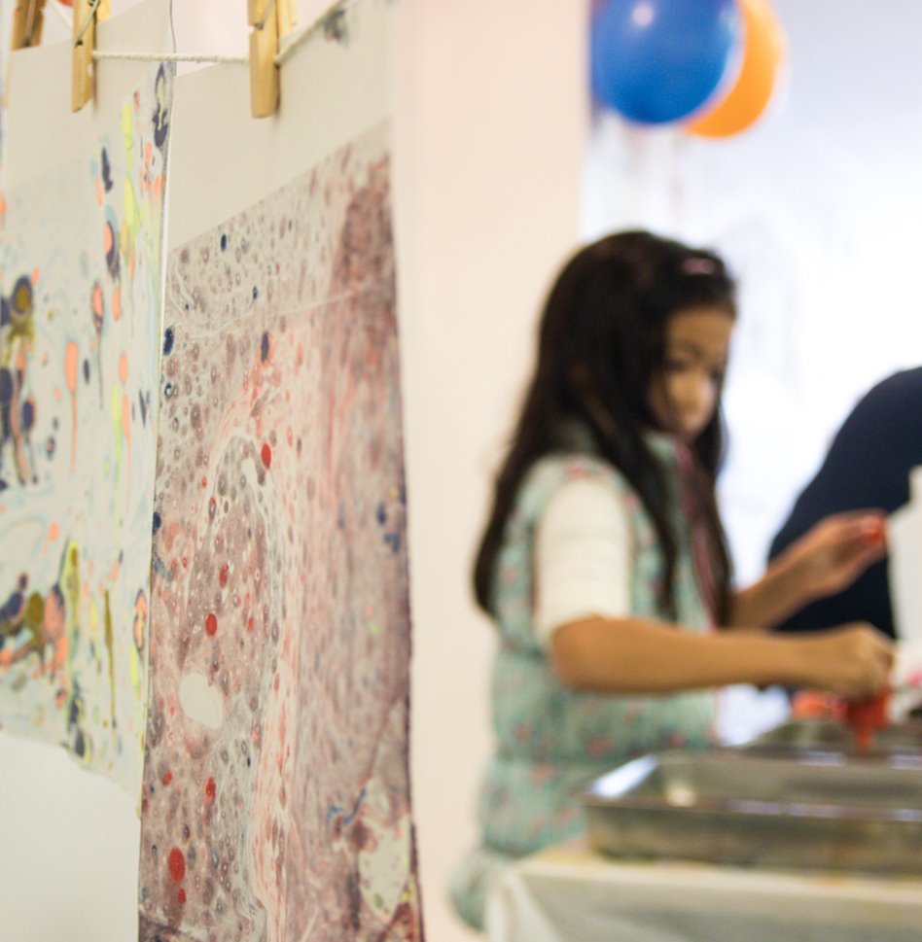
Full applications
Open on Grantium on Tuesday 28 May 2024
Deadline is 12pm (midday) on Thursday 15 August 2024
See applicant guidance for detailed breakdown of the application form
© Yorkshire Festival
Almeida – This Isn’t (A True Story) © Ali Wright
Cornwall Museum Partnership. Photo © James Stuart
#LetsCreate
Notes:
Please note that if you are invited to submit a full application, this is not a guarantee that the application will go on to be successful.
In previous rounds we have invited about 50 applications.
Historic England will complete site visits throughout this period

Slide 15
Inflation and your MEND application
Consider rising inflation levels in the construction industry in your application
Strongly recommend you seek professional advice
Arts Council England will not increase grants once awarded
It is not possible to reduce the scope of works post-award due to rising inflation
Inflation should be considered as separate from general contingency
See our Terms and Conditions for more information
© Yorkshire Festival
Almeida – This Isn’t (A True Story) © Ali Wright
#LetsCreate
Notes:
Inflation levels in the construction industry are rising at the moment, and we need applicants to ensure that you have taken this into consideration when you are writing their application for MEND.
We strongly advise all applicants to seek professional advice on this element of their budget. Arts Council England will not increase grants once awarded, so if inflationary increases mean that applicants do not have enough funds to complete your project, you will need to source additional funding elsewhere to complete the works outlined in the funding agreement. It is not possible to reduce the scope of works post-award due to rising inflation. Please see our terms and conditions for more information about grant-holder obligations under the funding agreement and agreed programme of works. To avoid this issue, we suggest working with your professional team to calculate a realistic, future-facing figure for your expenditure.
It is important that in your application you show clearly what your inflation figure is, and how it has been calculated. Please be aware that inflation should be considered as separate from general contingency, and should be represented separately in your application. This will help us to understand your budget and the appropriateness of your figures.

Slide 16
Decision making
Arts Council England assess the applications against the three criteria
Programme Advisory Panel will provide recommendations to Arts Council England
The panel includes Historic England, Department for Culture, Media & Sport (DCMS), and the National Lottery Heritage Fund
Arts Council England will make the final decisions on successful applications
May make reduced awards
© Yorkshire Festival
Almeida – This Isn’t (A True Story) © Ali Wright
#LetsCreate
Notes:
Once we receive your applications, how will we make our decisions?
Arts Council England will assess all applications, considering how each application meets the criteria set out in the applicant guidance; meeting the brief, management of the activity, and financial viability. This is supported by comments received from Historic England.
The Programme Advisory Panel will review applications and assessments and will provide recommendations to Arts Council England.
The panel will include representatives from Historic England, Department for Culture, Media & Sport (DCMS) and the National Lottery Heritage Fund.
Arts Council England will make the final decisions on successful applications. To do this, we will consider how strongly the activity scored against our criteria, as well as considering the five balancing factors. We will also consider the activity alongside other applications to the fund.
To ensure that we can use the available funding to make the maximum impact across the museum sector, we may make reduced awards (ie offer grants for less than applied for). It is therefore essential that applications make clear how costs have been calculated, how works can be phased (if relevant), and which works are most urgent.

Slide 17
Balancing criteria
Geographic spread
Priority Places and Levelling Up for Culture Places
Risk
Type of museum
Project scale
© Yorkshire Festival
Almeida – This Isn’t (A True Story) © Ali Wright
Thinktank Birmingham Science Museum. Photos by David Rowan and Andy Stammers © Birmingham Museums Trust
#LetsCreate
Notes:
The Programme Advisory Panel will decide how well each application will fit into a balanced portfolio of grants. In doing this, they will consider five factors to balance the projects funded against the available budget. These factors will be used in addition to the main criteria to ensure a good spread of funded projects and to differentiate between proposals that are considered fundable.
The five factors we will consider are:
● geographic spread – we will take into account the need to support museums across England
● Priority Places and Levelling Up for Culture Places – we will consider whether the organisation is based in an area of low cultural investment, as set out in the Arts Council’s Priority Places for investment, and the Levelling Up for Culture Places, and well as areas of low cultural engagement, as per the Active Lives Survey
● risk – the extent of the risks to the overall balance of projects
● type of museum – the range and type of museum (such as size, collection type and governance model)
● project scale – we will consider the need to achieve a mix of projects of varying grant sizes and delivery timescales within the available budget
There is no mechanistic formula for balancing the final list of awarded projects. This is a framework against which we will make an informed judgement about how each project might contribute to the overall mix in the context of the funds available to distribute.
Now I'll hand over to my colleague Clare Charlesworth at Historic England

Slide 18
Historic England
Technical support for MEND
How will it work?

Slide 19
Stage 1: Expression of Interest Review
Historic England has an in house team of building professionals including architects, surveyors and building services engineers
Historic England will be providing technical advice to Arts Council England on all applicants invited to submit a full application to the MEND fund, regardless of whether the buildings included in a Museum’s application are historic or not
Historic England representatives sit on the programme advisory panel, which sifts Expressions of Interest and makes recommendations on full applications
Notes:
Stage 1: EOI Review
Historic England has an in house team of building professionals including architects, surveyors and building services engineers
Historic England will be providing technical advice to Arts Council England on all applicants invited to submit a full application to the MEND fund, regardless of whether the buildings included in a Museum’s application are historic or not
Historic England representatives sit on the programme advisory panel, which sifts expressions of interest and makes recommendations on full applications

Slide 20
Stage 2: Site Visits and Advice
Historic England building professionals will contact applicants to arrange a site visit
Based on the site visit and further supporting information, Historic England will consider how the proposed project meets the aims of MEND as detailed in the scheme criteria within the applicant guidance
Historic England will provide applicants with advice on any improvements that should be made before the full application is submitted
Notes:
Stage 2: Site Visits and Advice
Historic England building professionals will contact applicants to arrange a site visit, which is your opportunity to ask questions
Based on the site visit and further supporting information, Historic England will consider how the proposed project meets the aims of MEND as detailed in the three criteria within the applicant guidance
Historic England will provide applicants with advice on any improvements that should be made before the full application is submitted, in the form of a written report. This is the extent of the advice that HE can provide, so we would strongly suggest that your professional team are available during the site visit.

Slide 21
Stage 3: Full applications
Once the full applications are received, Historic England will provide Arts Council England with comments on projects against the three criteria, and check that the advice given in the site visit comments have been incorporated
Historic England comments will feed into Arts Council England’s assessment process, which will inform decision making
Notes:
Stage 3: Full applications
Once the full applications are received, Historic England will provide Arts Council England with comments on projects against the three criteria, and check that the advice given at Stage 2 has been incorporated
Historic England comments will feed into Arts Council England’s assessment process, which will inform decision making

Slide 22
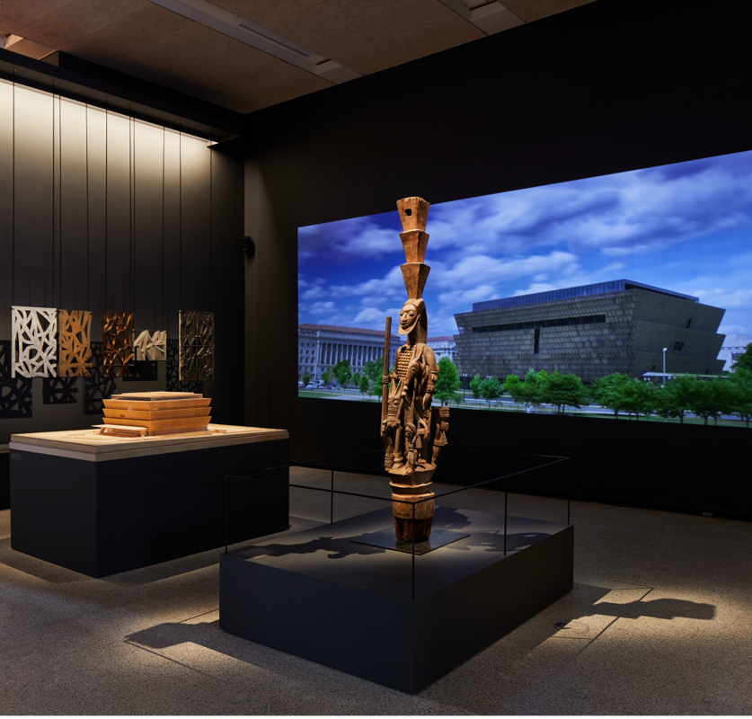
Q&A
artscouncil.org.uk/MEND
Full guidance and Easy Read
Frequently Asked Questions
Building Excellence in the Cultural Sector
Contact: enquiries@artscouncil.org.uk
Smithsonian National Museum of African American History and Culture. David Adjaye: Making Memory exhibition at the Design Museum. Photo: @ Ed Reeve
#LetsCreate
Notes:
Before we begin the Q&A session, here is a reminder of where you can find further information and support:
You can visit the MEND webpage at artscouncil.org.uk/MEND. Here you can find the applicant guidance in full, as well as an Easy Read version
We also have a Frequently Asked Questions section, which we'll be updating after this webinar
We’ll try to answer as many of your questions as possible today, but if we aren’t able to answer your question, or if you require access support with your application, please email enquiries@artscouncil.org.uk
We will also upload this webinar recording and presentation slides to the webpage
If you are invited to submit a full application then there will be a further webinar to support with the technical elements of your application
We'll now take a short five-minute break, please feel free to put your questions in the Q&A chat box at the bottom or top of your screen and we'll be back in a moment to answer your questions.

