Slide 1
LIBRARIES
IMPROVEMENT
FUND
ROUND 3
Webinar 1 - Introduction
Storyhouse – Children's Library Photo © Mark Carline
#LetsCreate
Notes:
Welcome & housekeeping
Thank you for joining us today for this webinar for the third round of the Libraries Improvement Fund.
We'll start soon but before we do, a little bit of housekeeping:
- We are joined today by two BSL interpreters, Molly Possart and Anna Curd, who have "BSL interpreter” in their screen name. You can use the three dots over their picture to pin them to your screen if you want to see them throughout the session
- We also have live captions available, to switch those on click the ‘Live transcript’ button at the top or bottom of your screen
- The webinar will take the form of a presentation followed by a Q&A session
- Please post questions in the Q&A box and we’ll either provide a written answer or we’ll answer them live in the webinar
- We are recording this session so if you wish to remain anonymous you can check the "send anonymously" box when posting a question.
This is part 1 of 2 and is designed as an introduction to the fund as well as a recap for those who have applied before, we’ll also highlight some areas of focus and a few tips about applying.

Slide 2
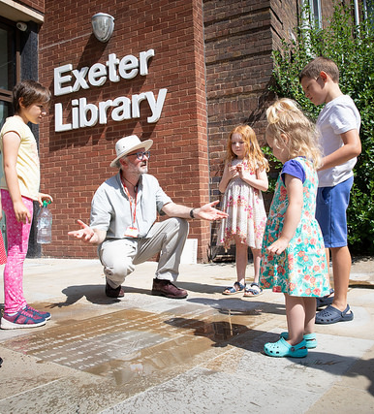
Graeme Calvert – Senior Officer, Collaborative Funding (Capital)
Sophie Lancaster – Senior Manager, Libraries Development Team
Briony Anderson – Senior Officer, Collaborative Funding (Capital)
© Yorkshire Festival
Almeida – This Isn’t (A True Story) © Ali Wright
Libraries Unlimited - Launch of the Summer Reading Challenge. Photo © Andy Casey
#LetsCreate
Notes:
Let me introduce our panel for today:
[each member introduces themselves] Graeme Sophie Briony
Briony will be our question master for today

Slide 3
Round 3 Overview
LIF R3 has a budget of £10.5 million
Grants of £50,000 to £499,999
Capital expenditure only – orgs capital policies
Only Local Authorities can apply as lead applicant
Other libraries (e.g. CMLs) can benefit as partners
Funding from 1 April 2024 – 31 March 2027
Projects must begin by 1 July 2024
We encourage ambitious projects – beyond BAU
Previous applicants/grantees can apply
© Yorkshire Festival
Almeida – This Isn’t (A True Story) © Ali Wright
#LetsCreate
Notes:
There is a £10.5m budget for the 23-24 round- it's a double round; this is the funding from two financial years combined because, as we've seen from R1&R2 figures, much of that demand is not being met by the current budget and we know that unsuccessful R1 & R2 apps will be coming back in with revised bids as well as some new applicants. Furthermore, with rising costs we’re expecting higher average bid amounts
As per previous rounds, Applicants can apply for grants for between £50k - £499,999. Again, there is no minimum level of match funding for this round but on average successful applicants to round 1 & 2 have found around 25% of the total project cost from other sources – this can be LA funding, crowdfunding, commercial income, funding from partners or support in kind
This fund can cover capital expenditure costs only – we define capital expenditure as an amount spent to acquire, maintain or improve fixed assets such as equipment, furniture, fixtures, vehicles or buildings that will be capitalised on the grantee’s balance sheet. This a legal requirement of the funds we receive from government to pay for LIF projects. If you can’t capitalise it, we can’t pay for it so check with your accounts team and the LIF guidance if you’re unsure.
Only Local Authorities can apply to this fund, other libraries can benefit as partners provided they contribute towards the LA’s statutory function but our funding agreements must be with Local Authorities and therefore they are the only organisations that can apply
Funding period is 1 April 2024-31 March 2027 and Projects must begin by 1 July 2024
This is a competitive fund and we are anticipating high demand again this year, but there is also more money available so we encourage ambitious projects that go beyond Business As Usual and that are exciting and interesting. We’re looking for projects that solve problems and provide opportunities for users.
And those who applied for R1 & R2 will be able to apply again for R3 – however if competition is high then we may prioritise applicants who have not previously been funded/applied and also new geographic areas/projects.
Finally, this is the last confirmed round of LIF – we do not know if there will be any funding for future rounds, so if you want to apply, now is the time.

Slide 4
Aims of the fund
Investment in digital infrastructure and physical spaces to:
Increase the sustainability and potential for transformation of libraries by developing more flexible, more commercial spaces
Increase and improve digital access within communities
Connect libraries to their communities and increase library use
© Yorkshire Festival
Almeida – This Isn’t (A True Story) © Ali Wright
#LetsCreate
Notes:
As with Round 1 & 2 it is anticipated that the fund will be investing in the following broad categories:
investment in digital infrastructure such as computers, interactive tech and software
as well as
investment in physical spaces whether it’s the structure of the space itself or the facilities within it
Through these project types the fund aims to:
increase the sustainability and potential for transformation of libraries by developing more flexible, more commercial spaces
increase and improve digital access within communities
connect libraries to their communities and increase library use

Slide 5
Timeline
Expression of Interest (EOI)
EOIs Considered & invites
Application
Assessment & Balancing
Final
Decisions announced
17 Apr –
19 Jun 23
19 Jul –
18 Sep 23
March
2024
© Yorkshire Festival
Almeida – This Isn’t (A True Story) © Ali Wright
#LetsCreate
Notes:
LIF uses a two-stage application process. The first stage is an expression of interest – these are shorter and quicker than a full application and they notify us of your intention to apply. After reviewing the EoIs we will then decide how many EoIs to invite to make a full application
EoIS open on Grantium at 9am on 17 April 2023
Deadline is 12pm (midday) on 19 June 2023
Reviews will take place over the following weeks & projects that show potential to deliver against the aims and outcomes of the fund will be invited to submit a full application
Full apps open on Grantium at 9am on 19 July 2023
Deadline is 12pm (midday) on 18 September 2023
Final decisions will be made at the end of February 2024 and we will be notifying applicants and making announcements in March with Funding Agreements to follow at the end of March/start of April. Projects will begin from April 2024 and can run for as lnog as anywhere up to 3 years, finishing by 31/3/2027

Slide 6
Project types
Building projects
Non-building
Structural work
Accessible toilets/facilities
Mechanical, Electrical & Plumbing (MEP)
Refurbishment
Sensory/play areas
Accessibility & SEND-focused projects
Computers, tablets, WiFi, interactive tech, makerspaces
Software & licenses
Furniture and new/movable shelving
Purchase of vehicles
© Yorkshire Festival
Almeida – This Isn’t (A True Story) © Ali Wright
#LetsCreate
Notes:
We classify eligible LIF projects into two basic types - building projects and non-building projects and we’ll have a look at the difference between the two in a minute, but to give you an idea of the types of work we can support here’s an overview of some of the things funded in the first two rounds.
Structural changes such as extensions, heavy refurbishments & ‘making good’ – so this might involve not just the implementation of things like the building of an extension, but also the removal, we’ve seen walls knocked through, fitted furniture removed, toilets and kitchens ripped out, escalators being removed, all so something different can be put into place like performance or workshop areas, sensory play areas. We’ve seen entranceways reconfigured to make them more accessible for disabled users and parents with pushchairs and prams etc.
Mechanical, Electrical & Plumbing work – upgrades & improvements or new work to make libraries more comfortable and accessible or to allow for more computers for example
New floors/ceilings to accommodate digital equipment and new electrical work
Accessibility / SEND-friendly projects particularly for libraries where this has been identified as a priority – some libraries have looked at their internal design and signage alongside wider structural changes to make a space that works for everyone
Purchase of digital equipment such as computers, Hublets, interactive technology – there’s a been a strong focus on providing digital provision to library users and to transforming libraries as cultural and creative hubs and the implementation of makerspace technology and areas. Self service kiosks out of hours access, RFID updates.
Upgrading or introduction of new software for library management
Installation of accessible/changing places toilets
Purchase and installation of movable shelving to allow for better use of space for ULO type programming
Your project might be one of these things or a combination of things depending on the needs of your library. When it comes to building projects or non-building projects, you might be wondering whether or not this applies to you and what the implications are, which I’ll cover on the next two slides so, first of all….

Slide 7
Is it a building project?
Likely, if any Statutory Approvals are required.
Planning permission
Building Regulations approval Listed Building consent
Construction/demolition
Mechanical, Electrical, Plumbing (MEP) work
Amendments to internal structures
Not required for MEP? Explain briefly
Unsure – get in touch!
© Yorkshire Festival
Almeida – This Isn’t (A True Story) © Ali Wright
#LetsCreate
Notes:
Is it a building project? Likely, if any Statutory Approvals apply/are require. There are a few different types of Statutory Approval but the main ones for LIF are:
Planning permission (outline or full) – this is usually only required if you’re building something new like a new building or an extension or to the local environment such as car parking, for example.
Building Regulations approval – these cover new buildings and extensions, but also apply to new mechanical, electrical and plumbing work taking place internally, new floors ceilings and amendments to internal structures.
Listed Building Consent – if your library is in a listed building and you want to make changes to it.
SO if your project is entirely based around asset purchase, you won’t need these and therefore don’t need to think about it. However if there is any level of electrical work going on, or new flooring, for example, we will assume that building regs approval is required as a minimum, because it probably will be. If it is not (for example if you are working with an independent contractor who is qualified to assess and sign off the project without Local Planning Authority approval – you MUST tell us about this in the app otherwise it may be deemed ineligible. Not sure? Get in touch.
- - -
Notes for reference only:
Building Regulations approvals can be sought either from the building control department of the local authority or from an approved inspector. In either case, a fee will be payable, relative to the type of building and the construction cost. Fee schedules can be obtained from the building control department of the local authority. It is now also possible for competent persons to self-certify that their work complies with the building regulations without submitting a building notice or incurring local authority fees.
Full plans or building notice
Generally on larger, new-build projects, a 'full plans' application will be made, meaning that full details of the proposed building works are submitted for approval before the works are carried out.
On small projects, or when changes are made to an existing building, approval may be sought by giving a 'building notice'. In this case, a building inspector will approve the works as they are carried out by a process of inspection. This does leave the client at risk that the completed works might not be approved, resulting in remedial costs.
Planning permission is the legal process of determining whether proposed developments should be permitted. Responsibility for planning lies with local planning authorities (usually the planning department of the district or borough council). The legislation, policy and guidance that underpins planning in England can be found on the government's National Planning Practice Guidance website.
Other than permitted developments, (which are considered to have insignificant impact), all developments require planning permission. The Town and Country Planning (General Permitted Development) Order 1995 sets out details for developments that might be permitted without requiring a planning application.
The Ministry of Housing, Communities and Local Government (MHCLG) decides national planning policy for England and this is set out in the National Planning Policy Framework.
Detailed and outline planning applications
Planning applications can be detailed or outline:
Outline planning applications can be used to find out whether a proposed development is likely to be approved by the planning authority before substantial costs are incurred developing a detailed design. Outline planning applications allow the submission of outline proposals, the details of which may be agreed as 'reserved matters' applications at a later stage. NB: Applying for outline planning consent may not fall within the scope of services for members of the consultant team unless it has been separately identified under 'other activities'
Detailed planning applications submit all the details of the proposed development at the same time.
Planning risk
Planning permission can be the greatest risk on a construction project.
Deciding whether to make an outline or detailed application, and when to make an application is of great importance. Typically, clients wish to secure planning permission as soon as possible so as to minimise abortive design costs. However, being granted planning permission may become more likely as the design develops and more details can be provided to the planning authority.

Slide 8
Building projects and RIBA Plan of Work
Stage 0 – Strategic Definition
Stage 1 – Planning and Preparation
Stage 2 – Concept Design
Stage 3 – Spatial Coordination – by 18 September 2023
Stage 3 Technical Drawings & Cost Plan
Informed by earlier Access Audit
Stage 4 – Technical Design
Stage 5 – Manufacturing & Construction
Stage 6 – Handover
Stage 7 – Use
© Yorkshire Festival
Almeida – This Isn’t (A True Story) © Ali Wright
#LetsCreate
Notes:
Now, you might be asking why is it important whether we consider it a building project or not? Well, if we deem your project to be a building project we will require some additional information from you at the full application stage – so this is by the time full apps are submitted in September. These include Technical Drawings and a Cost plan developed to the standard of RIBA (Royal Institute of British Architects) stage 3.
The RIBA Plan of Work 2020 is a procedural guide for architects and construction working on building projects. There are 8 stages in this plan as desomnatrated on screen here. So let’w walk through stages 0 to 3:
Stage 0 – Strategic Definition
Stage 1 – Planning and Preparation
Stage 2 – Concept Design – this is where your first drawings might come in, they might be hand drawn sketches or 3d rendered artistic concepts but you couldn’t hand it to a building team and say ‘make me this’, it’s more so the architect can say io the client ‘is this the sort of thing you were after?’
Stage 3 – Spatial Coordination
Between now and the autumn you will find yourself working through these first 4 stages, in fact for may of you you may already have done some or all of this work.
After stage 3 you go into the technical design stage before actually doing the work and putting it into use
So what is Workstage 3 and why do we require it? Well, it’s called Spatial coordination and, as the name suggests it’s where the idea, or the initial concepts and sketches, are coordinated within to the space in which the work is to be done. The architectural concept is validated through surveys and design coordination across design disciplines for example. architecture and structural and mechanical & electrical engineering design studies and analysis. SO qualified people will look at the work to date, measure up the existing space, measure up the work to take place, test it out, plan it and draw it up. It will be drawn to scale so we’ll usually see measurements or scales in there, there might be design notes such as key material components like timber flooring, they might include floor plans and/or elevations and/or cross sections. These drawings allow us to not only visualise the work to be carried out but it shows us that it is viable and, crucially, gives the cost consultant a level of detail that allows them to more accurately estimate the cost of the project. They’ll be able to go ah right I need 100 square metres of timber flooring or 3 weeks of site management and labour fees. This is the sort of info that goes in the cost plan. A cost plan is a document that outlines how much everything will cost in terms of construction, so it’ll cover things like your materials costs, site management and labourers fees, preliminaries (on-site overheads for construction). They’ll also include assumptions, exclusions, potential risks and their costs and information on who prepared it. They won’t cover income or non-construction costs.
It’s imperative the Cost Plan is based on the stage 3 drawing as this will provide the most up to date and accurate reflection of the expected costs. If you’re working with an architect or cost consultant (such as a quantity surveyor) they will prepare these documents so ask them for these docs to be developed up to stage 3 for submission with your app.
For building projects we also ask that an access audit is carried out by an independent access consultant. This is not part of RIBA workstage 3, in fact this would usually take place at an earlier stage such as stage 1, but access audits should inform the Stage 3 work so that designs reflect some or all of the access recommendations (with rationale provided for recommendations not incorporated into designs).

Slide 9
Access Audits
Content:
Finding out about the venue and/or events
Getting to the venue (transport, parking etc.)
Physical accessibility
Signage and getting around
On-site support
Communications materials, braille, etc.
Recommendations for improvements
Strong projects respond to the recommendations of the audit
Aim for best practice beyond the Equalities Act
© Yorkshire Festival
Almeida – This Isn’t (A True Story) © Ali Wright
#LetsCreate
Notes:
What is it? It’s a report, carried out ideally by an independent auditor that looks at the accessibility of your venue. It is not an assessment of how your venue meets the Equalities Act 2010, it goes beyond that.
Finding out about the venue and/or events
Getting to the venue (transport, parking etc.)
Physical accessibility
Signage and getting around
On-site support
Communications materials
Braille,
Recommendations for improvements
Why we ask for it?
This is mandatory for building projects because of the nature of the work but we would recommend everybody carry out an access audit if possible, they can be done from anywhere from a couple of hundred pounds to a few thousand. Depending on library size, level of audit etc.
We want to see the libraries current accessibility strengths AND weaknesses. Your site will have both. It is highly unlikely that any given place in the UK is 100% perfectly accessible and we don’t expect them to be. But one of the focuses of this programme is about identifying where things can be better and addressing them. This is where this comes in:
We are looking for projects respond to the AA, focusing on best practice in line with our strategy – not basic meeting the Equalities Act (or Disability Discrimination Act which was replaced by Equalities Act in 2010). Stronger projects in R1 & R2 directly responded to access audits. A statement of compliance is not an audit.
Independent auditors preferred.

Slide 10
Eligible Costs
Yes ✓ | No ✗
Construction Materials, prelims & fees | Book stocks
Mechanical, electrical and plumbing (MEP) | Programming costs – Performance fees Workshop fees Producer/Director Fees
Equipment purchases | Marketing & promotion
Software licenses | Ongoing running costs
Furniture & digital asset purchases | Costs incurred before we can make a decision (Access Audits, RIBA 1-3)
Capital Project Management fees | Anything below de minimis limit as per your org’s capital policy
Contingency AND Inflation | Other non-capital costs
© Yorkshire Festival
Almeida – This Isn’t (A True Story) © Ali Wright
#LetsCreate
Notes:
There are restrictions on what this funding can be spent on, first of all only costs that will be capitalised on your balance sheet can be included, and secondly only spending that takes place after we’ve made our decisions are eligible.
Yes ✓
Construction materials, preliminaries & fees
MEP: Mechanical, electrical and plumbing costs
Materials & Fees
Equipment purchases
Software licenses
Furniture & digital asset purchases
Capital Project Management fees
Contingency AND Inflation
No ✗
Book stocks
Programming costs
Performance fees
Workshop fees
Producer/Director Fees
Marketing & promotion
Ongoing running costs
Costs incurred before we can make a decision (Access Audits, RIBA 1-3)
Anything below de minimis limit as per your org’s capital policy
Other non-capital costs
If you’re not sure. DON’T RISK IT – get in touch.

Slide 11
Expression of Interest (EoI)
Basic details – project cost, bid amount, project dates
Statutory approvals & RIBA design stage
Details of library site(s)
Project description:
Details of the proposed project
Evidence of need
Contribution to the aims and outcomes of LIF
Details of preparatory work
Any partnership funding or in-kind support
Previous grantees - how you would manage multiple projects and how it will benefit a wider group of people
© Yorkshire Festival
Almeida – This Isn’t (A True Story) © Ali Wright
#LetsCreate
Notes:
Apologies as this slide is a bit wordy but this is all in the LIF guidance document so I’ll quickly cover what is in the EOI here. The EoI is like a smaller version of a full app, it’s your notification to us that you want to apply.
Basic details – cost, bid amount, dates
Statutory approvals & RIBA design stages
Details of library site(s)
Details of your proposed project
Evidence of need – we’re going to talk more about this on the next slide
Contribution to the aims and outcomes of LIF
Details of preparatory work
Any partnership funding or in-kind support
Previous grantees - how you would manage multiple projects and how it will benefit a wider group of people

Slide 12
Writing the project description
Overview of the library service​
What work will be carried out?​
What items will be purchased?​
When will all this happen?​
Which site(s) will it happen at?​
Who will it benefit?​
Why? - Evidence of need
Assume we know nothing – test it with someone unfamiliar with the project
© Yorkshire Festival
Almeida – This Isn’t (A True Story) © Ali Wright
Beeston Library. Photo © Neil Pledger
#LetsCreate
Notes:
As some general advice, every application, whether as aprt of the EoI or the basica details section of the full application, should include a succinct overview of the project, think of it as a sort of elevator pitch if you had to explain it to someone who is completely unfamiliar with the project. Because even if you’re spoken to your Relationship Manager or our Enquiries Team or even myself, not everyone who reviews your appilcaiotn will be familiar with it – so assume we know nothing and provide us with a brief overview using who what where when why as a basic model. In it include things like:
Overview of the library service​
What work will be carried out?​
What items will be purchased?​
When will all this happen?​
Which site(s) will it happen at?​
Who will it benefit?​
Why? - Evidence of need
So for example you might say
We manage 11 library sites across the county. We’ll be renovating the main library spaces at 2 of our sites [name the 2 sites] by removing an old kitchen, knocking through two walls, replacing fitted shelving with new movable shelves to create a sensory area for children, install changing facilities, new self service kiosks, purchase furniture and Hublets to make a more accessible and inclusive library space. These improvements respond to the needs of our library users who have cited digital poverty, and a lack of provision for under 10’s as the main barriers to access. The entire project and it’s reasons for being in around 100 words. You can then go into further detail about the benefits and the research etc. but it’s always nice to start by painting a picture of the project.

Slide 13
Evidencing need
Why this particular project & why now?
Feedback from users & communities
Surveys and focus groups
Library/LA priorities
Access Audits
Research/Data
Local communities and their needs
Appropriate solution(s)
(The project)
Impact(s)
© Yorkshire Festival
Almeida – This Isn’t (A True Story) © Ali Wright
#LetsCreate
Notes:
Evidencing need was the number one thing that separated the strong applications from the not so strong and as such, one of the main areas for development we identified from Round 1 & 2.
This is a competitive programme and to make a strong case you need to justify why the project is needed, and therefore how your project provides solutions that address the needs and wants of your local communities. We’ve seen a lot of appilcants in the past retrofitting an argument to their desired project. So what many did was say X is a poor/deprived/underprivileged area so we’re going to refurbish the space and build meeting rooms. There isn’t a connect there. This does not demonstrate a project that aims to resolve an existing issue or fulfil a need.
Strong projects should begin with local needs and work to fill them. We want to see strong consultation with library users and local communities to evidence need. Why this project and why now? The really strong ones involve their users and communities at every step of the way to ensure it’s meeting those needs. So some of the ways you can evidence need is by
Feedback from users & communities
Surveys and focus groups
Library/LA priorities
Access Audits
Research/Data
On the next slide we’ll have a look at some good examples from Round 1 & 2

Slide 14
Evidencing need case studies
SEND-led projects - to improve spaces and facilities
Extended opening hours tech – for local adult users who work shift patterns
Families with under 5’s - New entranceway, internal/external refurbishment & changing facilities
Accessible surveys & access audit – giving every library user a voice and responding to need
Use of space & commercial potential – demand outstripped resource
© Yorkshire Festival
Almeida – This Isn’t (A True Story) © Ali Wright
#LetsCreate
Notes:
So let’s have a look at some examples from Rounds 1 & 2 where evidencing need has been done well. Now, disclaimer, we’re still in the midst of funding agreement development and announcing round 2 decisions will take place next month so I’ve left these as anonymous and they’re focused more around themes and project types rather than specific individual projects Send-led: We’ve seen some great SEND projects around improving spaces and facilities. The stronger ones have directly involved children and parents or service users directly in the decision making and design process. So surveys and focus groups as a standard, we’ve also seen a library Service that had previously worked in partnership with SEND children and their parents who actually assessed libraries and provided feedback which was used to improve the service offer. Going one further, there’s an example where redesign itself is being carried out with children, young people, design team to realise a vision that is child-led. Gold standard not just in evidencing need but in inclusion – the impact here is that the end result will be exactly what the library users need and want
Extended hours – Again, we’ve seen a few examples of this - libraries conducted research with their users and local communities and found out many are shift workers or working when the library is opens and so always access the library during normal opening hours and they requested longer opening hours. So the correct solution was to install out of hours entrances and self-service kiosks. Again, they clearly identified an existing issue and determined the appropriate solution. The impact here is more library users and more flexibility for existing users. Families with under 5’s - This is a specific example of a Round 1 funded library that works closely with the Family Clinic and has the highest number of under five registrations in the region. They conducted a survey of all customers on how to spend money to improve the library, the number one improvement was a new access to the children’s library because of the narrow and inaccessible entrances, as well as accessible toilets and changing facilities and redeveloping external areas that have attracted anti-social behaviour directed at the library which, understandably, puts some people off. The key here is that they identified their target audiences clearly as families with children under 5 and users of the family clinic, and then asked them what they wanted the money to be spent on and did that. Again, library users get what they need
Accessible surveys – Again, few different projects including complete library refurbishments including new flooring, new electrics, movable shelving, play/sensory area for children, interactive digital equipment, a stage area and improved design to improve accessibility. What I liked about some of these projects was that the surveying they carried out with library users was accessible by design worked with their delivery partners to ensure they got this right, ensuring all voices could be heard and also examples where the accessibility improvements were based on recommendations from the access audit so we knew they would be beneficial and were necessary. Audits recommending changing signage, colours, physical access – automated doors, levelling uneven floors, accessible toilets, that sort of thing Use of space & commercial potential – we’ve seen a few examples of internal restructures and refurbishments where libraries have an existing programme of activities that can range from using the library as a performance space or a workshop space but that there simply wasn’t enough room in the library to meet the demands of local community groups, schools and this not only limited use but also the commercial potential. So we’ve seen libraries looking at knocking through walls, removing fixed shelving and replacing with movable shelving, making new rooms and new spaces to accommodate these. Evidencing this has again been carried out in consultation with these groups. This is an interesting one because here they were also able to make a strong case for any income that would be generated because they were able to identify who the users would be. Too many projects we’ve seen a “oh we’re making a new space so it’s going to help us generate more funds” – the question you need to answer is “who is going to use this space, how many more groups or classes will this allow you to accommodate and how much money will it generate?”
The thing that ties all these together is
They all started with developing an evidence base that was not just anecdotal but measurable and with a quality of depth
They put library users and local communities right in the heart of that process
That helped them to not only solve problems also create opportunities for library users too
These are just some examples, there are plenty of others

Slide 15
Before you apply
Have you set up an applicant profile for the library/local authority on our application portal?
Do you own the freehold or leasehold (minimum 5/10 years - see guidance for reqs) on the property where the work will take place?
Building projects – following the RIBA design stages (stage 3 completion required by full application deadline in September 2023)
Unsure? – get in touch via RM or enquiries
© Yorkshire Festival
Almeida – This Isn’t (A True Story) © Ali Wright
#LetsCreate
Notes:
Have you set up an applicant profile for the library/local authority on our application portal? – This should be in the name of the library service or Local authority but the legal name and bank name that you provide us here should be the LA we can only pay into LA bank accounts. Do this asap as they take a few days to be authorised as we have checks to do on each profile.
Applicants must hold freehold or leasehold of property where the work will be carried out/ assets stored/used.
Lease length requirements:
Building projects = 10 years without a break clause
Non-building projects = 5 years without a break clause
If there is a break clause, it is possible to negotiate a Deed of Variation before payments are released on successful grants – contact us if you’re unsure.
Building projects – are you following the RIBA design stages? Remember for the Expression of interest you don’t need to have completed stage 3 yet but we do need to see stage 3 drawings an stage 3 cost plans by the point of application on 18 September 2023

Slide 16
Balancing Criteria & Decision Making
EoI panel & Programme Advisory Panel will review applications and assessments against balancing criteria:
Geography - inc. Priority Places and Levelling Up for Culture Places
Risk and deliverability
Strategic fit (Let’s Create)
Type of project
Final decisions made by Arts Council England's Executive Board
© Yorkshire Festival
Almeida – This Isn’t (A True Story) © Ali Wright
#LetsCreate
Notes:
EoIs are considered by a panel of representatives from ACE & DCMS.
Full applications are considered by a Programme Advisory Panel which is made up of both ACE and DCMS staff as well as representatives and experts from the library sector.
In making our decisions and recommendations the panels review applications against balancing criteria:
Geography, including Priority Places and Levelling Up for Culture Places
Risk and deliverability
Strategic fit (Let’s Create)
Type of project
These are criteria we use when difficult decisions have to be made, for example if most of the strongest applications came from one area, we may end up with an unfairly skewed investment so we can use geographic balancing to move the money to another area.
Final decisions made by ACE Executive Board

Slide 17
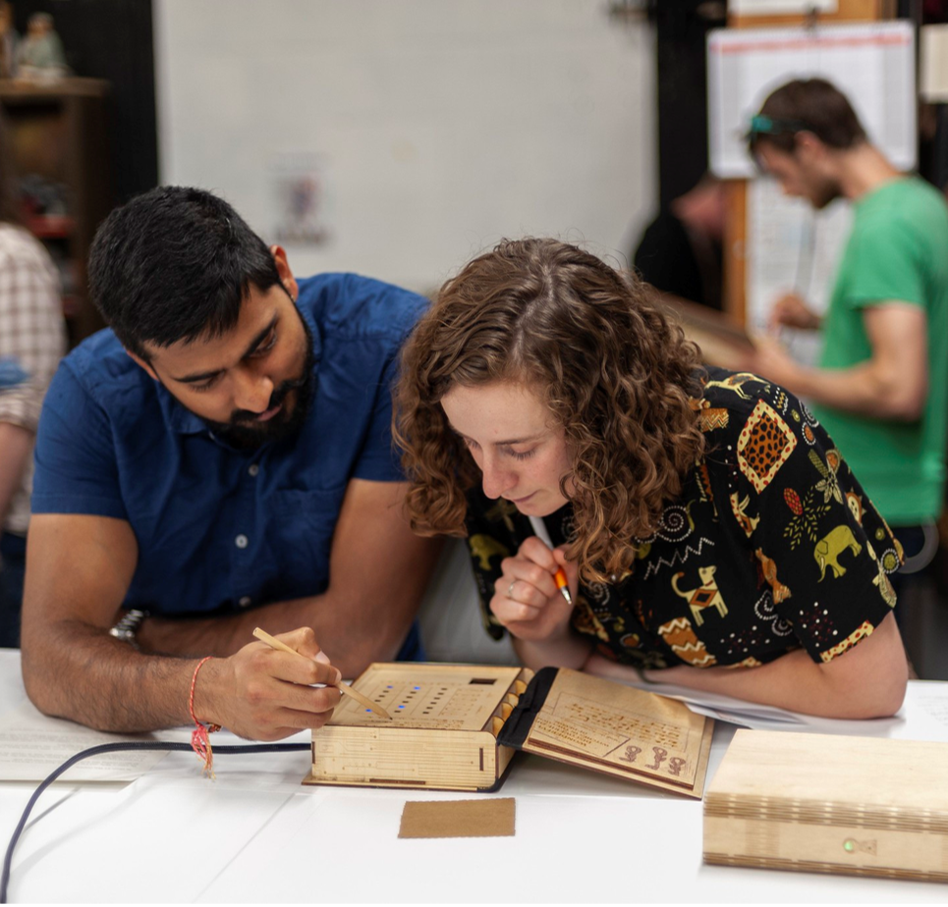
Webinar 2 –
Full Applications
July 2023:
Brief recap of this webinar
RIBA stage 3 - design drawings/cost plans
Access audits​
Budgets & Cashflows​
Costed Risk Registers​
Procurement method statements
Common mistakes and challenges​
Hints & tips​
Almeida – This Isn’t (A True Story) © Ali Wright
#LetsCreate
Notes:
If invited to make a full application, we will be hosting a further webinar once the apps are open for application online. In it we will cover:
Recap of some of the info in this webinar – building projects, evidencing need, eligible costs etc.​
Common mistakes and challenges​
Hints & tips​
RIBA stage 3 - design drawings/cost plans/access audits​
Budgets & Cashflows​
Costed Risk Registers​
Procurement method statements

Slide 18
Q&A
artscouncil.org.uk/LIF
Full guidance and Easy Read
Frequently asked questions
Building Excellence in the Cultural Sector
Contact: enquiries@artscouncil.org.uk
Photo © Jill Jennings / Wakefield Libraries and Information Services
#LetsCreate
Notes:
Before we begin the Q&A session, here is a reminder of where you can find further information and support:
You can visit the LIF webpage at artscouncil.org.uk/LIF. Here you can find the applicant guidance in full, as well as an Easy Read version
We also have a Frequently Asked Questions section, which we'll be updating after this webinar
Building excellence in the cultural sector is an ACE document which provides a lot of good advice around
We’ll try to answer as many of your questions as possible today, but if we aren’t able to answer your question, or if you require access support with your application, please email enquiries@artscouncil.org.uk
We will also upload this webinar recording and presentation slides to the webpage
Just to reiterate -, this is the last confirmed round of LIF – we do not know if there will be any funding for future rounds, so if you want to apply, now is the time.
We'll now take a short five-minute break, please feel free to put your questions in the Q&A chat box at the bottom or top of your screen and we'll be back in a moment to answer your questions.
[Q&A]
-- Thanks for listening.

